Slide 1

COM114
Generative AI – Image Quality Assessment

Slide 2
Image quality Assessment
FID score
KID score
IS score
CLIP score

Slide 3

Image Quality Assessment
  Fréchet inception distance (FID) score
    To measure how close a set of fake images to a set of real images
    The smaller the FID value, the better quality the set of fake images
    Pre-trained inception-v3 is utilized

Slide 4
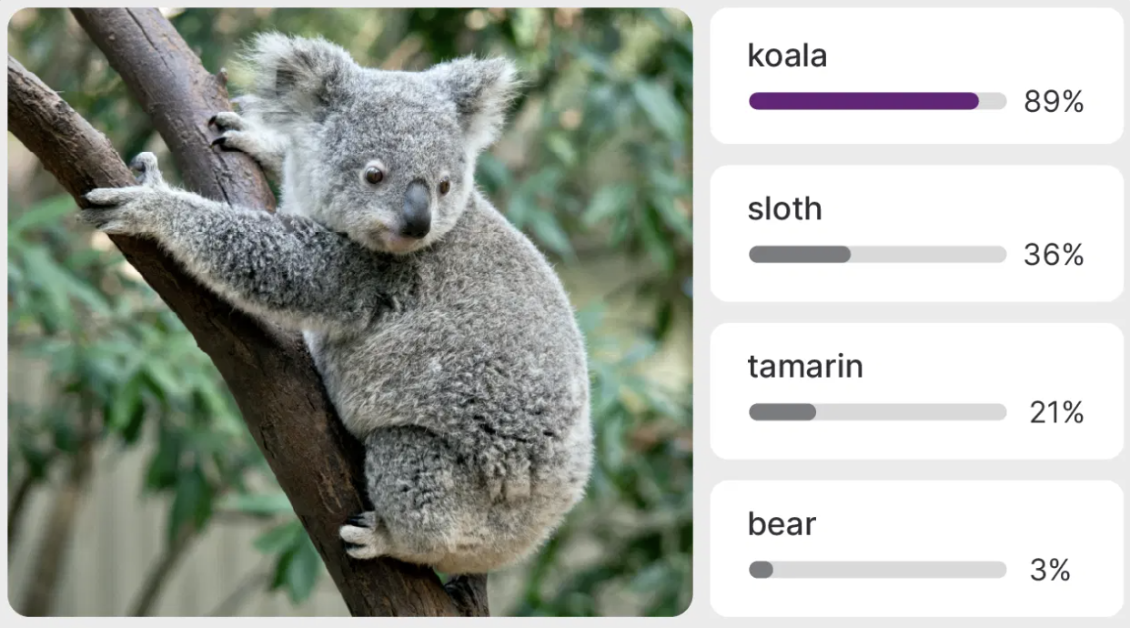
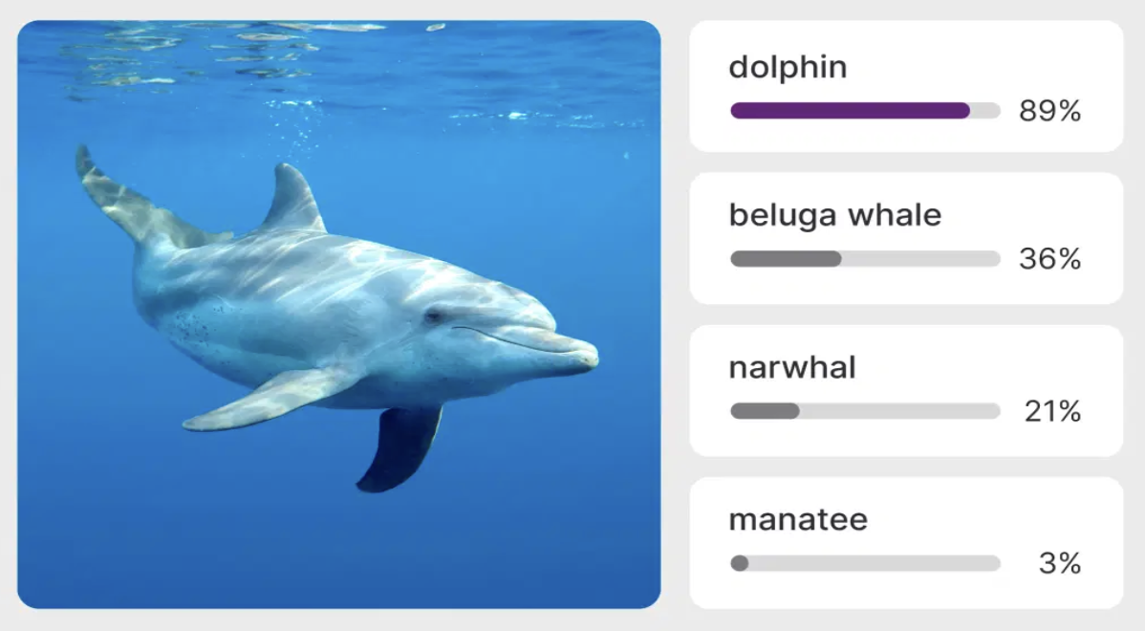
Pre-trained inception-v3
  Google's Inception v3 is a convolutional neural network designed for image recognition and classification, trained on the large ImageNet database. It is 48 layers deep and capable of classifying images into 1000 categories, with an input size of 299x299 pixels.

Slide 5


FID score (1)
  Pipeline for computing FID score
fake
images
feature
vectors
pre-trained
inceptionv3 network
fitting
Gaussian
distribution
$$(μ_{f}, Σ_{f})$$
compute
difference
FID
score
real
images
feature
vectors
pre-trained
inceptionv3 network
fitting
Gaussian
distribution
$$(μ_{r}, Σ_{r})$$

Slide 6
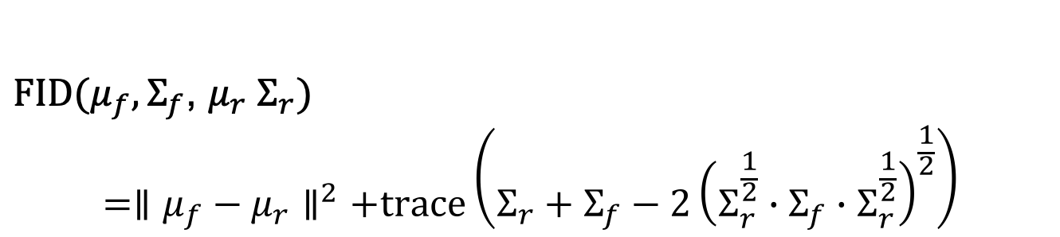

FID score (2)
- Formula for Computing FID score
${FID(μ}_{f}, Σ_{f}$, $μ_{r} Σ_{r})$
$$={∥μ_{f}−μ_{r}∥}^{2}+trace\left(Σ_{r}+Σ_{f}−2{\left(Σ_{r}^{\frac{1}{2}}∙Σ_{f}∙Σ_{r}^{\frac{1}{2}}\right)}^{\frac{1}{2}}\right)$$
$$≥0$$
- Typical number of images for computing FID
- 10K images -30K images

Slide 7
A note on FID score
- Trace of a matrix

Slide 8
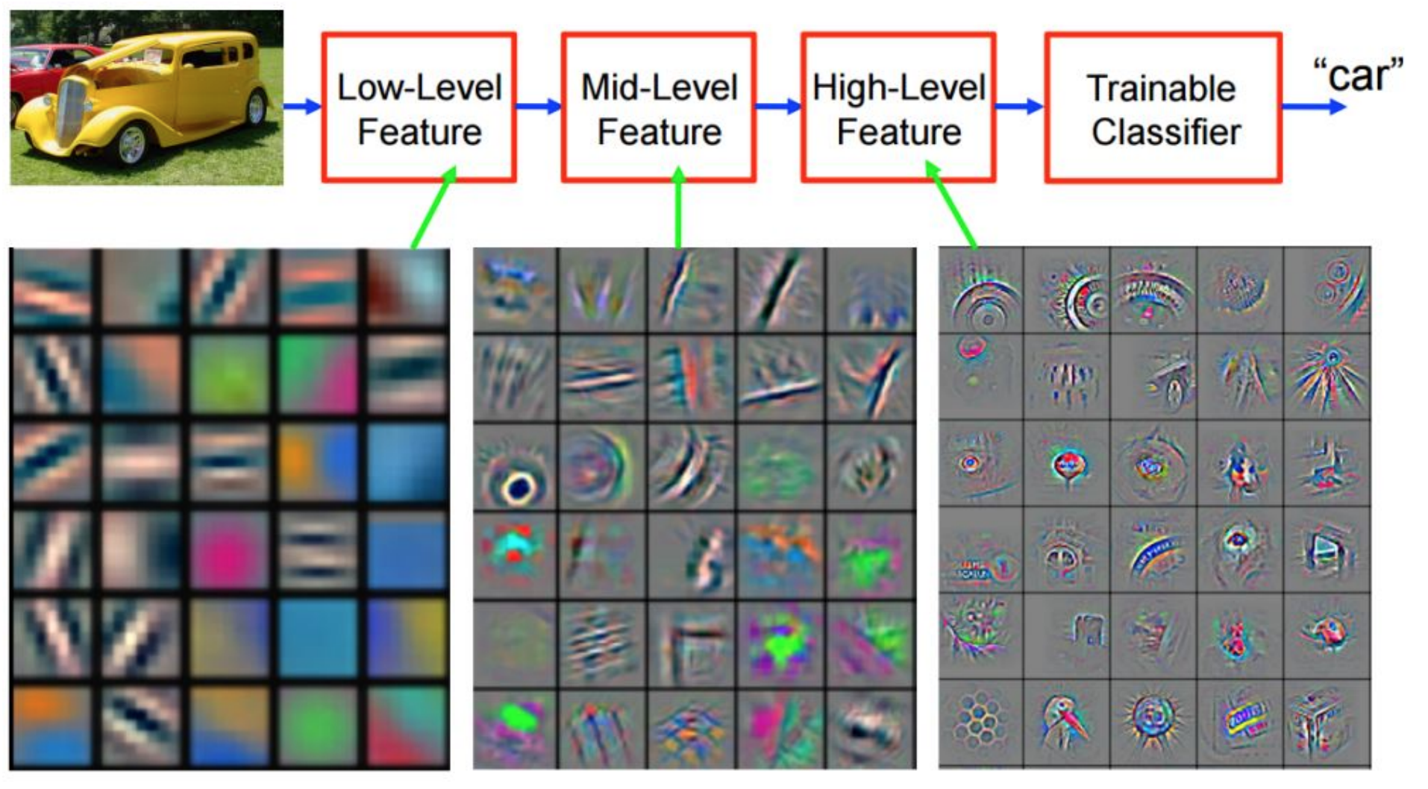
FID score (3)
  Pipeline for computing FID score
Why using feature vectors to compute FID?
- It was shown to correlate well with human judgement of visual quality
neural network
M. D. Zeiler and R. Fergus, “Visualizing and understanding convolutional networks”, in ECCV. Springer, 2014.

Slide 9
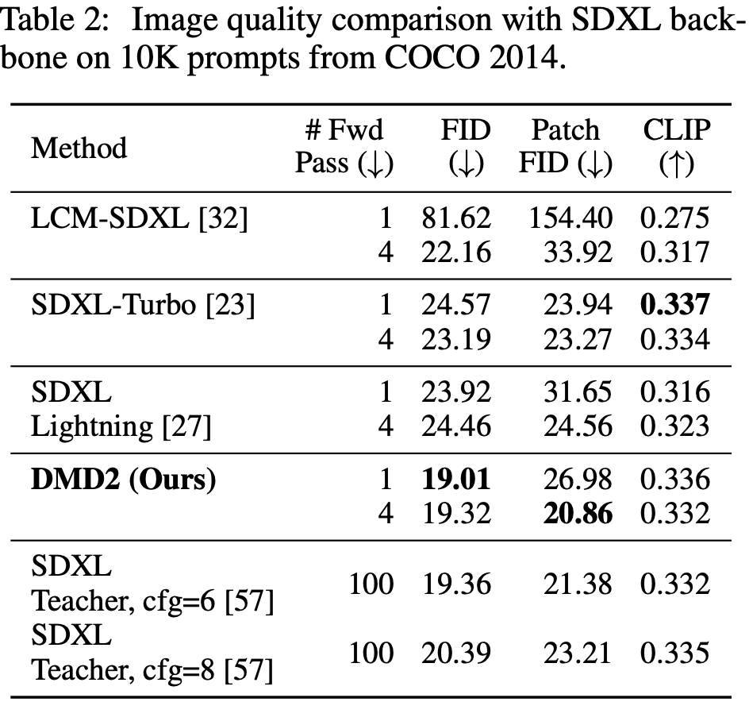
FID score (4)
State-of-the-art performance on COCO 2014
”Improved Distribution Matching Distillation for Fast Image Synthesis”, https://arxiv.org/pdf/2405.14867, 2024

Slide 10
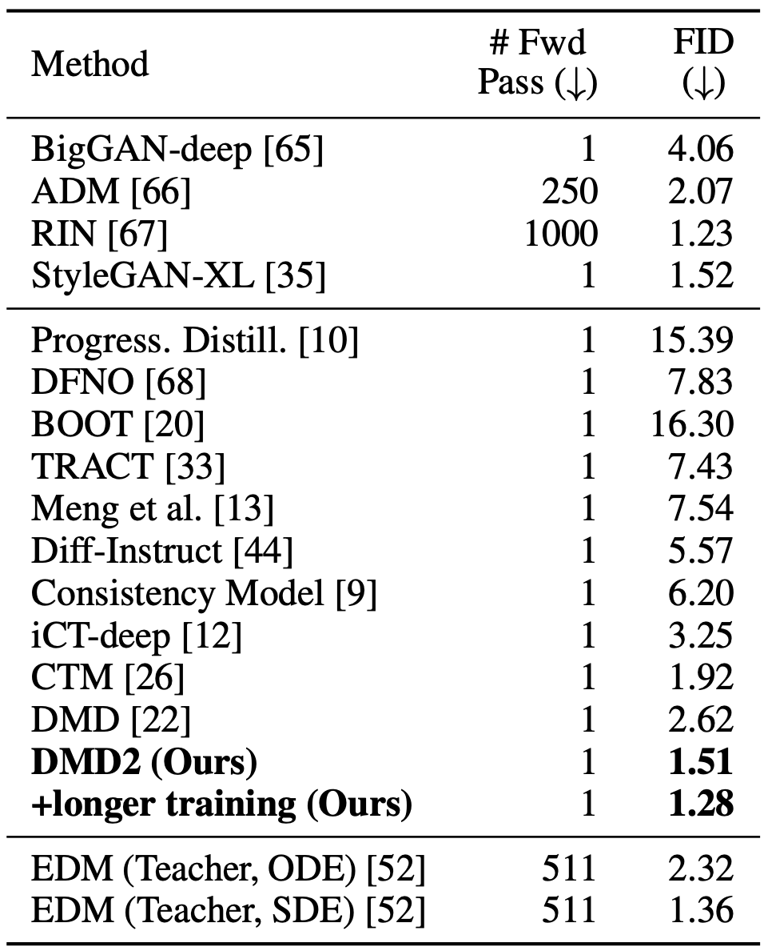
FID score (5)
State-of-the-art performance on ImageNet 64
“Improved Distribution Matching Distillation for Fast Image Synthesis”, https://arxiv.org/pdf/2405.14867, 2024

Slide 11
FID score (6)
Comprehensive evaluation: FID evaluates both the visual quality and the diversity of generated images in a single metric.
Better correlation with human judgment: FID scores are shown to correlate well with how humans perceive the quality of generated images.
Robustness: It is more robust than some older metrics like Inception Score (IS), particularly in identifying issues like mode collapse.
Sensitivity to image features: The metric uses features from the Inception v3 model, which helps capture subtle nuances in images, leading to a more accurate assessment.
Clear interpretation: A lower FID score consistently means the generated images are more similar to real images. A score of 0 indicates the distributions are identical.
Useful for model comparison: FID allows for the comparison of different generative models or the impact of changes within a single model, making it easier to track progress.

Slide 12
FID score (5)
  Variants of FID
Fréchet Audio Distance (FAD)
  Measurement of fake audio quality
Fréchet Video Distance (FVD)
  Measurement of fake video quality
Fréchet ChemNet Distance (FCD)
    Measurement of fake molecule quality

Slide 13
Kernel Inception Distance (KID)
  Basic Idea:
    Uses a polynomial kernel to compute the Maximum Mean Discrepancy (MMD) between real and generated feature distributions.
  Does not assume Gaussian distribution (unlike FID).
  Lower KID indicates better quality (similar to FID).

Slide 14
KID (1)
  Calculating KID
    Feature Extraction: Process batches of real images (𝑋) and generated images (Y) through a pre-trained Inception network to obtain feature vectors for each image.
    MMD Estimation: Compute an empirical estimate of the squared MMD using the extracted feature vectors.
    Averaging: The computation is often repeated over multiple random subsets (splits) of the data, and the results are averaged to obtain a more stable KID estimate.

Slide 15
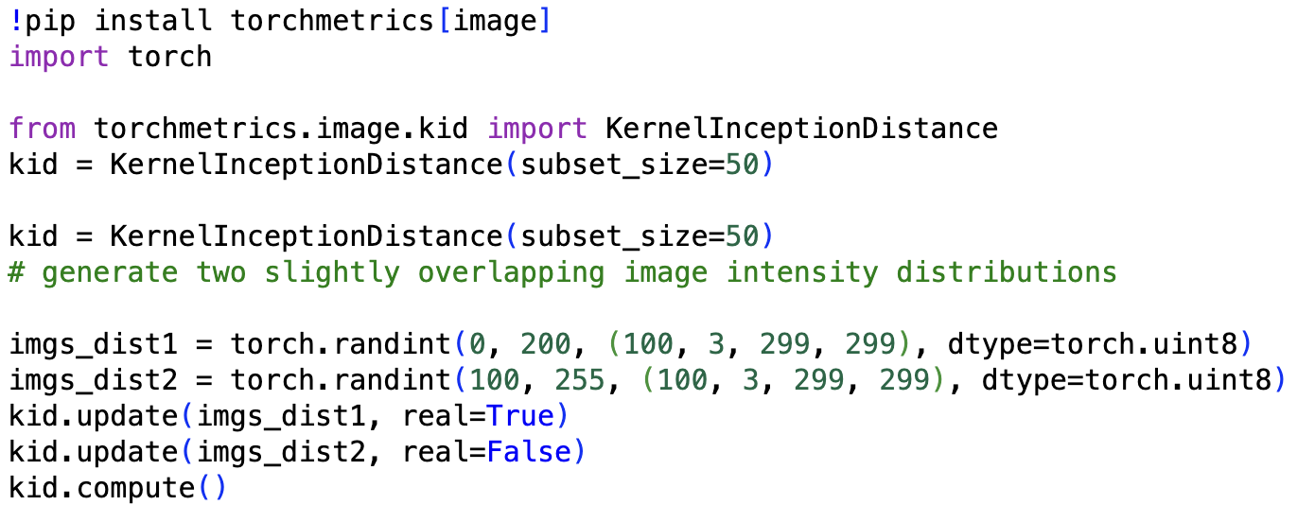
KID (2)
Pytorch Code:

Slide 16
Inception score (IS) (1)
  IS score measures both the image fidelity and diversity.
  The larger the IS value, the better quality the set of fake images
  Pre-trained inception-v3 is utilized

Slide 17
Inception score (IS) (2)
  Step 1: Get conditional probability
    Feed each generated image into a pre-trained Inception v3 model to obtain .
    is a probability vector over the 1000 classes in ImageNet.
    A low entropy of indicates high image quality.

Slide 18
Inception score (IS) (3)
  Step 2: Get marginal probability
Calculate the marginal probability distribution by averaging the conditional probabilities across all generated images.
A diverse set of images should have a high entropy in this distribution, meaning all classes are represented.

Slide 19
Inception score (IS) (4)
  Step 3: Compute KL divergence
    Calculate the KL divergence between each conditional probability and marginal probability .
    This measures how different the probability distribution is for a single image compared to the average distribution across all images
Notes:
$D_{KL}(p(y|x_i)|| p(y)) = \sum_{j=0}^{999}p(y=j|x_i) \log \frac{p(y=j|x_i)}{p(y=j)} $

Slide 20
Inception score (IS) (5)
  Step 4: Compute the average KL values
  Step 5: Compute the final IS score
Notes:
$D_{KL}^{ave} = \frac{1}{n} \sum_{i=1}^n D_{KL}(p(y|x_i)|| p(y))$

Slide 21
CLIP Score
  CLIP score
    CLIP score is for text-to-image generation
    To measure how close a fake image is aligned to the provided text.
    The larger the CLIP value, the higher alignment for the text-image pairs.

Slide 22
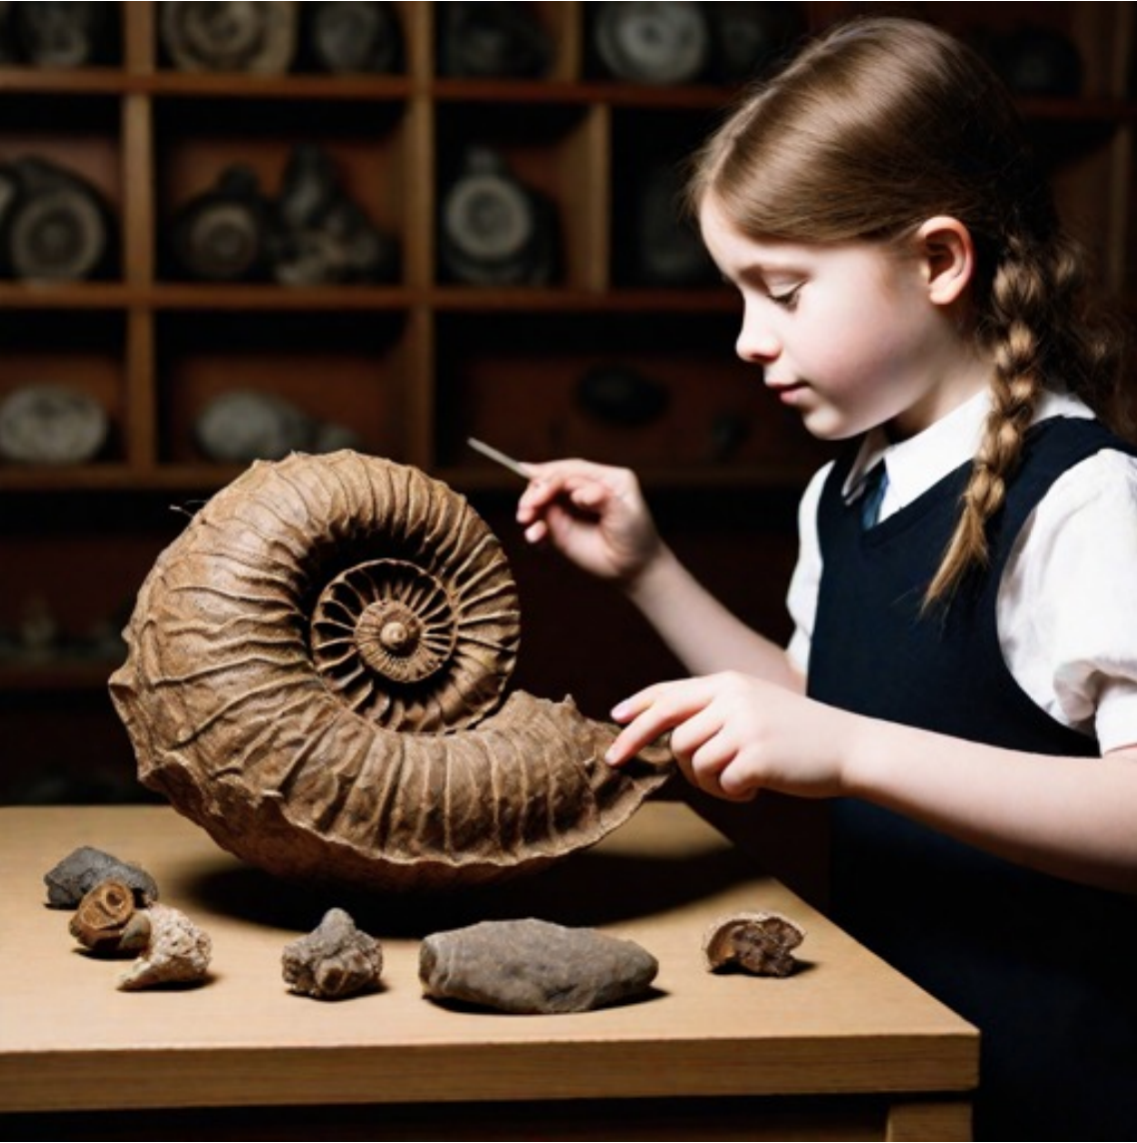
CLIP score (1)
  Demonstration of text-to-image generation
D
Gaussian
noises
diffusion-based
sampling
“a girl examining
an ammonite fossil”
CLIP score measures the correlation between the text prompt
and the generated image

Slide 23

CLIP score (2)
  Demonstration of text-to-image generation
D
Gaussian
noises
diffusion-based
sampling
“a girl examining
an ammonite fossil”
Different Gaussian noises lead to different fake images

Slide 24
CLIP score (3)
  Formula for computing CLIP score
image
encoder
text
encoder

Slide 25
CLIP score (4)
State-of-the-art performance on COCO 2014
Ideal scenario: Low FID score and high CLIP score

Slide 26
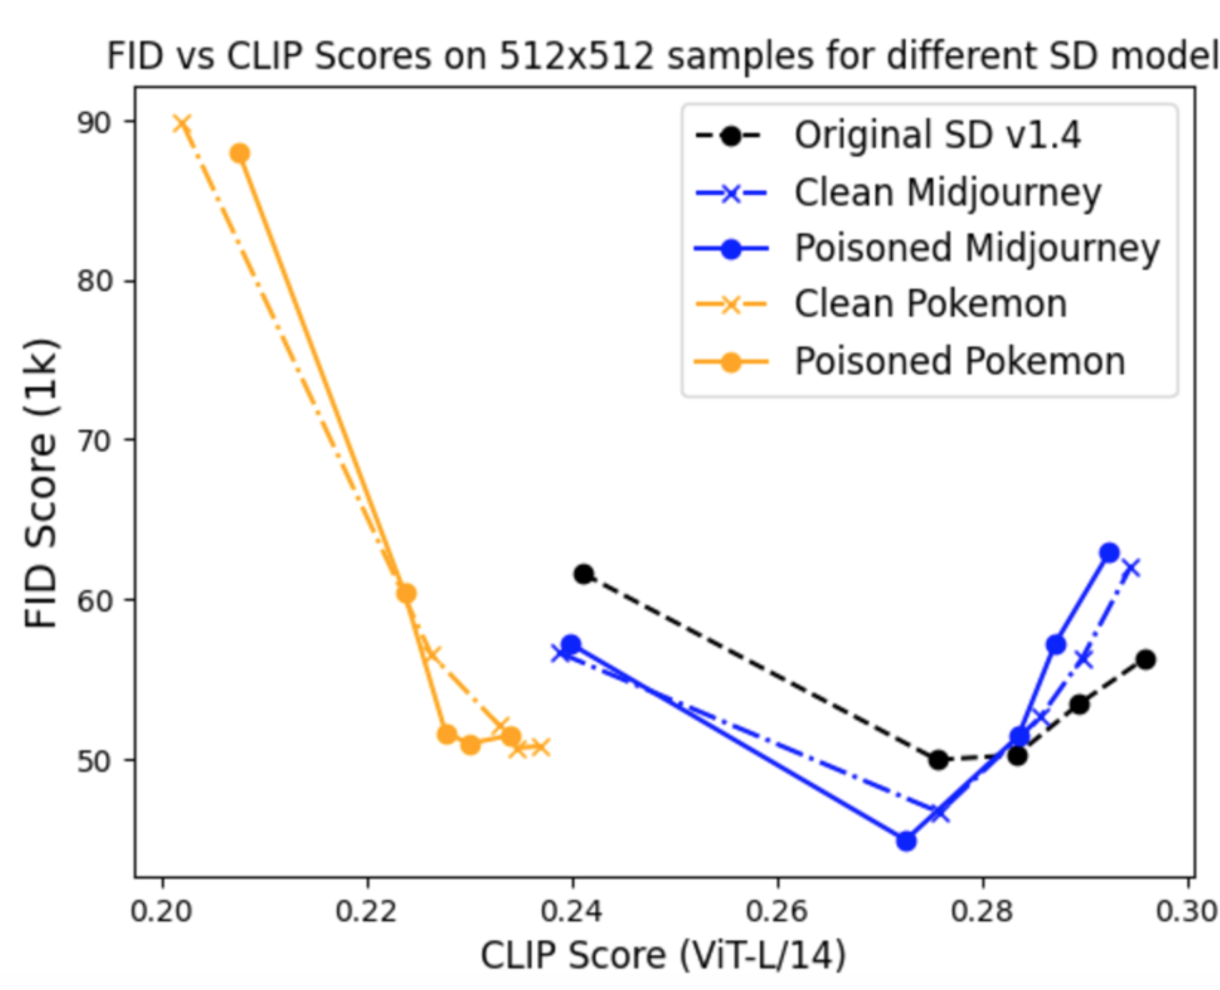
FID-CLIP curve
Ideal scenario: Low FID score and high CLIP score

Slide 27
Difference between FID and CLIP
  FID is computed by measuring the distance between a set of fake images and a set of real images
  CLIP is computed by measuring a similarity between an image and a text prompt in the latent spaces.
  One can compute the average CLIP score for a number of text-image pairs to obtain a more reliable CLIP estimate.

Slide 28
References
- “Evaluation of Image Generation”, blog-link

